Slide 1
Employee data analysis using excel
STUDENT NAME : GAYATHRI.B
REGISTER NO : 312204795
User name : Asumn217312204795
DEPARTMENT : BACHELOR OF COMMERCE
COLLEGE : THIRUMURUGAN ARTS AND SCIENCE COLLEGE FOR WOMENS

Slide 2
Project title
Employee Performance Analysis
Using Excel

Slide 3
AGENDA
Problem Statement
Project Overview
End users
Our Solution and Proposition
Dataset Description
Modelling Approach
Results and Discussion
Conclusion

Slide 4
PROBLEM STATEMENT
When selecting criteria for evaluating employee performance, it’s important to tailor your choices to fit the specific goals and needs of your organization. Here are some key factors you might consider:
Job-Specific Skills: Evaluate how well employees perform the core tasks of their job. This includes technical skills, knowledge, and competency in their specific role.
Quality of Work: Assess the accuracy, thoroughness, and effectiveness of the work produced. High-quality work usually meets or exceeds standards and contributes to overall success.
Productivity: Measure how efficiently employees complete their tasks. This includes their ability to manage time, meet deadlines, and handle workload effectively.
.

Slide 5
PROJECT OVERVIEW
Analysis of data using employee database for their performance using different matrix
Employee performance refers to how effectively and efficiently an employee executes their job responsibilities and contributes to the organization's goals. It encompasses various aspects of an employee's work, including the quality, quantity, and impact of their output.

Slide 6
WHO ARE THE END USERS ?
The end users of employee performance data are the various stakeholders who utilize performance evaluations and related information to make informed decisions and enhance organizational effectiveness. Here’s a breakdown of the key end users:
1. EMPLOYEES
Self-Improvement: Employees use performance feedback to identify areas for personal growth and development .
Career Development: Insights from performance evaluations help employees set career goals and pursue professional development opportunities.
2. MANAGERS AND SUPERVISORS
Performance Management: Managers use performance data to assess employee contributions, set performance expectations, and make decisions about promotions, raises, and disciplinary actions.

Slide 7
Coaching and Support: Performance evaluations help managers provide targeted coaching and support to help employees improve and succeed.
3. HUMAN RESOURCES (HR) DEPARTMENT
Talent Management: HR uses performance data for workforce planning, talent acquisition, and succession planning.
Training and Development: Identifying skill gaps and performance issues enables HR to design and implement training programs.

Slide 8
OUR SOLUTION AND ITS VALUE PROPOSITION
Filtering employee performance involves sorting and analyzing performance data to make informed decisions about employee management, development, and rewards
Conditional formatting applied to employee performance data, it can help quickly identify trends, outliers, and areas needing attention. Here’s how to apply conditional formatting to employee performance data.
Pivot table to analyze employee performance data can provide valuable insights and help you summarize, analyze, and present performance information effectively

Slide 9
DATASET DESCRIPTION
Employee data set – Kaggle
26features
Feature - 9 feature
Employee id
Gender - male, female
Performance
Business unit
Name
Rating - numerical

Slide 10
THE “WOW” IN OUR SOLUTION
Exceptional Problem-Solving Skills: Employees who can tackle complex issues creatively and effectively often make a significant impact. Look for individuals who proactively address challenges and come up with innovative solutions.
Outstanding Communication: Employees who excel in both verbal and written communication can drive projects forward, facilitate better team collaboration, and improve client relations. Their ability to articulate ideas clearly and listen actively can be game-changing.
Leadership and Initiative: Those who go beyond their job description by taking on leadership roles, mentoring others, or spearheading new initiatives demonstrate a high level of engagement and commitment.

Slide 11
MODELLING
Data collection - books and google
Data cleaning - Define Data Requirements, Gather Data
Techniques - Regular Performance Reviews, Goal Setting and Management
Pivot table - to analyze employee performance data can provide valuable insights and help you summarize, analyze, and present performance information effectively

Slide 12


results

Slide 13
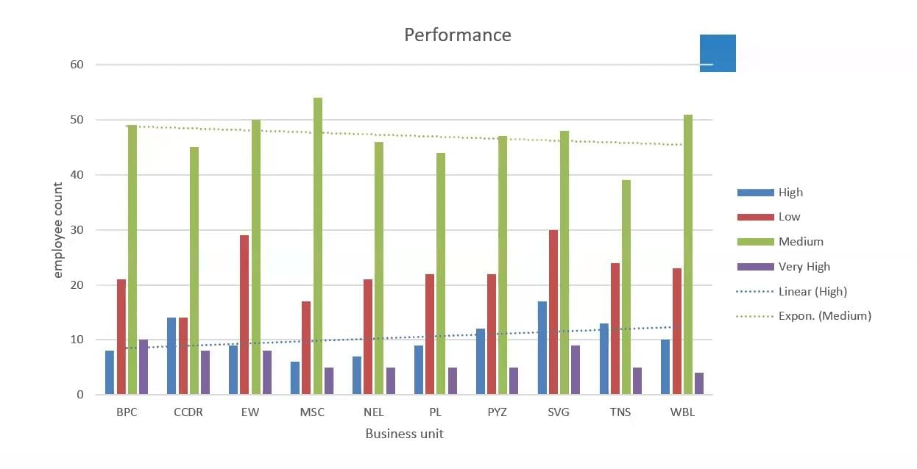
conclusion
Areas for improvment include time ,management ,teamwork ,and adopting to new process . Data-driven insights enable trageted interventioms ,leading to enhance employee development and organizational sucess
Notes:
Based on the Excel analysis of employee performers consistenly exceeded targets ,while some employees showed areas for improvement ,particulary in [specific tasks or metrics].to enhance overall performance ,targeted training and support are recommended for underperforming areas,along with recognition and reward for high acheivers. Continued monitoring and periodic reviews will help sustain and improve performance levels. Based on the Excel analysis of employee performers consistenly exceeded targets ,while some employees showed areas for improvement ,particulary in [specific tasks or metrics].to enhance overall performance ,targeted training and support are recommended for underperforming areas,along with recognition and reward for high acheivers. Continued monitoring and periodic reviews will help sustain and improve performance levels.
Based on the Excel analysis of employee performers consistenly exceeded targets ,while some employees showed areas for improvement ,particulary in [specific tasks or metrics].to enhance overall performance ,targeted training and support are recommended for underperforming areas,along with recognition and reward for high acheivers. Continued monitoring and periodic reviews will help sustain and improve performance levels.
Based on the Excel analysis of employee performers consistenly exceeded targets ,while some employees showed areas for improvement ,particulary in [specific tasks or metrics].to enhance overall performance ,targeted training and support are recommended for underperforming areas,along with recognition and reward for high acheivers. Continued monitoring and periodic reviews will help sustain and improve performance levels.
Based on the Excel analysis of employee performers consistenly exceeded targets ,while some employees showed areas for improvement ,particulary in [specific tasks or metrics].to enhance overall performance ,targeted training and support are recommended for underperforming areas,along with recognition and reward for high acheivers. Continued monitoring and periodic reviews will help sustain and improve performance levels.
Based on the Excel analysis of employee performers consistenly exceeded targets ,while some employees showed areas for improvement ,particulary in [specific tasks or metrics].to enhance overall performance ,targeted training and support are recommended for underperforming areas,along with recognition and reward for high acheivers. Continued monitoring and periodic reviews will help sustain and improve performance levels.
Based on the Excel analysis of employee performers consistenly exceeded targets ,while some employees showed areas for improvement ,particulary in [specific tasks or metrics].to enhance overall performance ,targeted training and support are recommended for underperforming areas,along with recognition and reward for high acheivers. Continued monitoring and periodic reviews will help sustain and improve performance levels.
Based on the Excel analysis of employee performers consistenly exceeded targets ,while some employees showed areas for improvement ,particulary in [specific tasks or metrics].to enhance overall performance ,targeted training and support are recommended for underperforming areas,along with recognition and reward for high acheivers. Continued monitoring and periodic reviews will help sustain and improve performance levels.
Based on the Excel analysis of employee performers consistenly exceeded targets ,while some employees showed areas for improvement ,particulary in [specific tasks or metrics].to enhance overall performance ,targeted training and support are recommended for underperforming areas,along with recognition and reward for high acheivers. Continued monitoring and periodic reviews will help sustain and improve performance levels.
Based on the Excel analysis of employee performers consistenly exceeded targets ,while some employees showed areas for improvement ,particulary in [specific tasks or metrics].to enhance overall performance ,targeted training and support are recommended for underperforming areas,along with recognition and reward for high acheivers. Continued monitoring and periodic reviews will help sustain and improve performance levels.
Based on the Excel analysis of employee performers consistenly exceeded targets ,while some employees showed areas for improvement ,particulary in [specific tasks or metrics].to enhance overall performance ,targeted training and support are recommended for underperforming areas,along with recognition and reward for high acheivers. Continued monitoring and periodic reviews will help sustain and improve performance levels.
Based on the Excel analysis of employee performers consistenly exceeded targets ,while some employees showed areas for improvement ,particulary in [specific tasks or metrics].to enhance overall performance ,targeted training and support are recommended for underperforming areas,along with recognition and reward for high acheivers. Continued monitoring and periodic reviews will help sustain and improve performance levels.
Based on the Excel analysis of employee performers consistenly exceeded targets ,while some employees showed areas for improvement ,particulary in [specific tasks or metrics].to enhance overall performance ,targeted training and support are recommended for underperforming areas,along with recognition and reward for high acheivers. Continued monitoring and periodic reviews will help sustain and improve performance levels.
Based on the Excel analysis of employee performers consistenly exceeded targets ,while some employees showed areas for improvement ,particulary in [specific tasks or metrics].to enhance overall performance ,targeted training and support are recommended for underperforming areas,along with recognition and reward for high acheivers. Continued monitoring and periodic reviews will help sustain and improve performance levels.
Based on the Excel analysis of employee performers consistenly exceeded targets ,while some employees showed areas for improvement ,particulary in [specific tasks or metrics].to enhance overall performance ,targeted training and support are recommended for underperforming areas,along with recognition and reward for high acheivers. Continued monitoring and periodic reviews will help sustain and improve performance levels.
Based on the Excel analysis of employee performers consistenly exceeded targets ,while some employees showed areas for improvement ,particulary in [specific tasks or metrics].to enhance overall performance ,targeted training and support are recommended for underperforming areas,along with recognition and reward for high acheivers. Continued monitoring and periodic reviews will help sustain and improve performance levels.
Based on the Excel analysis of employee performers consistenly exceeded targets ,while some employees showed areas for improvement ,particulary in [specific tasks or metrics].to enhance overall performance ,targeted training and support are recommended for underperforming areas,along with recognition and reward for high acheivers. Continued monitoring and periodic reviews will help sustain and improve performance levels.
Based on the Excel analysis of employee performers consistenly exceeded targets ,while some employees showed areas for improvement ,particulary in [specific tasks or metrics].to enhance overall performance ,targeted training and support are recommended for underperforming areas,along with recognition and reward for high acheivers. Continued monitoring and periodic reviews will help sustain and improve performance levels.
Based on the Excel analysis of employee performers consistenly exceeded targets ,while some employees showed areas for improvement ,particulary in [specific tasks or metrics].to enhance overall performance ,targeted training and support are recommended for underperforming areas,along with recognition and reward for high acheivers. Continued monitoring and periodic reviews will help sustain and improve performance levels.
Based on the Excel analysis of employee performers consistenly exceeded targets ,while some employees showed areas for improvement ,particulary in [specific tasks or metrics].to enhance overall performance ,targeted training and support are recommended for underperforming areas,along with recognition and reward for high acheivers. Continued monitoring and periodic reviews will help sustain and improve performance levels.
Based on the Excel analysis of employee performers consistenly exceeded targets ,while some employees showed areas for improvement ,particulary in [specific tasks or metrics].to enhance overall performance ,targeted training and support are recommended for underperforming areas,along with recognition and reward for high acheivers. Continued monitoring and periodic reviews will help sustain and improve performance levels.
Based on the Excel analysis of employee performers consistenly exceeded targets ,while some employees showed areas for improvement ,particulary in [specific tasks or metrics].to enhance overall performance ,targeted training and support are recommended for underperforming areas,along with recognition and reward for high acheivers. Continued monitoring and periodic reviews will help sustain and improve performance levels.
Based on the Excel analysis of employee performers consistenly exceeded targets ,while some employees showed areas for improvement ,particulary in [specific tasks or metrics].to enhance overall performance ,targeted training and support are recommended for underperforming areas,along with recognition and reward for high acheivers. Continued monitoring and periodic reviews will help sustain and improve performance levels.
Based on the Excel analysis of employee performers consistenly exceeded targets ,while some employees showed areas for improvement ,particulary in [specific tasks or metrics].to enhance overall performance ,targeted training and support are recommended for underperforming areas,along with recognition and reward for high acheivers. Continued monitoring and periodic reviews will help sustain and improve performance levels.
Based on the Excel analysis of employee performers consistenly exceeded targets ,while some employees showed areas for improvement ,particulary in [specific tasks or metrics].to enhance overall performance ,targeted training and support are recommended for underperforming areas,along with recognition and reward for high acheivers. Continued monitoring and periodic reviews will help sustain and improve performance levels.
Based on the Excel analysis of employee performers consistenly exceeded targets ,while some employees showed areas for improvement ,particulary in [specific tasks or metrics].to enhance overall performance ,targeted training and support are recommended for underperforming areas,along with recognition and reward for high acheivers. Continued monitoring and periodic reviews will help sustain and improve performance levels.
Based on the Excel analysis of employee performers consistenly exceeded targets ,while some employees showed areas for improvement ,particulary in [specific tasks or metrics].to enhance overall performance ,targeted training and support are recommended for underperforming areas,along with recognition and reward for high acheivers. Continued monitoring and periodic reviews will help sustain and improve performance levels.
Based on the Excel analysis of employee performers consistenly exceeded targets ,while some employees showed areas for improvement ,particulary in [specific tasks or metrics].to enhance overall performance ,targeted training and support are recommended for underperforming areas,along with recognition and reward for high acheivers. Continued monitoring and periodic reviews will help sustain and improve performance levels.
Based on the Excel analysis of employee performers consistenly exceeded targets ,while some employees showed areas for improvement ,particulary in [specific tasks or metrics].to enhance overall performance ,targeted training and support are recommended for underperforming areas,along with recognition and reward for high acheivers. Continued monitoring and periodic reviews will help sustain and improve performance levels.
Based on the Excel analysis of employee performers consistenly exceeded targets ,while some employees showed areas for improvement ,particulary in [specific tasks or metrics].to enhance overall performance ,targeted training and support are recommended for underperforming areas,along with recognition and reward for high acheivers. Continued monitoring and periodic reviews will help sustain and improve performance levels.
Based on the Excel analysis of employee performers consistenly exceeded targets ,while some employees showed areas for improvement ,particulary in [specific tasks or metrics].to enhance overall performance ,targeted training and support are recommended for underperforming areas,along with recognition and reward for high acheivers. Continued monitoring and periodic reviews will help sustain and improve performance levels.
Based on the Excel analysis of employee performers consistenly exceeded targets ,while some employees showed areas for improvement ,particulary in [specific tasks or metrics].to enhance overall performance ,targeted training and support are recommended for underperforming areas,along with recognition and reward for high acheivers. Continued monitoring and periodic reviews will help sustain and improve performance levels.
Based on the Excel analysis of employee performers consistenly exceeded targets ,while some employees showed areas for improvement ,particulary in [specific tasks or metrics].to enhance overall performance ,targeted training and support are recommended for underperforming areas,along with recognition and reward for high acheivers. Continued monitoring and periodic reviews will help sustain and improve performance levels.
Based on the Excel analysis of employee performers consistenly exceeded targets ,while some employees showed areas for improvement ,particulary in [specific tasks or metrics].to enhance overall performance ,targeted training and support are recommended for underperforming areas,along with recognition and reward for high acheivers. Continued monitoring and periodic reviews will help sustain and improve performance levels.

